Slide 1
Accelerating Customer Experience Innovation Through DevOps
Chivas Nambiar
Director, DevOps Platform Engineering
10.19.2015

Slide 2
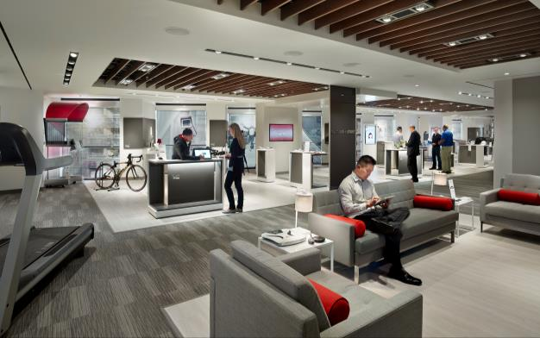


Who Is Verizon?
Facts
The best, most reliable networks in the industry
2014 Revenue: $127.1B
Fortune 15 Company
Customers
109.5M Wireless Retail
6.8M FiOS Internet
5.8M FiOS Video
99% of Fortune 500
Company
178K Employees worldwide
150+ countries
1,700+ retail locations
Notes:
We are Verizon
We run some of the best, most reliable, most ubiquitous networks of their kinds in the world.
A variety of customers- Consumer Wireless, Consumer Internet, Voice and TV, Small and Medium businesses, Large Enterprises
10s of thousands of employees, organized around delivering relevant and useful products and experiences to this heterogenous customer base

Slide 3




Tipping Point : Where We Started Our Journey
The Challenge → CoFEE
Internet, TV, Phone
Millions of Customers
Thousands of users
Not This
Converged Front End Engine
One-Stop Customer Relationship Management
A business challenge that required agility to overcome!
Notes:
Acronym city. A century+ of being part of an industry that is very acronym friendly. (and yes, we have run out of 2 and 3 letter acronyms)
Cofee basics:
When you call in, when a technician comes to your house, when you self service
Interfaces, offers and products, historical information
10s of thousands of reps
10s of thousands of technicians out in the field
The “Converged” part was aspirational
In 2010, we had 44 systems
Think systems through legacy environments, acquisitions, technology refreshes
Gateways on top of gateways on top of gateways (It is gateways all the ways down!)

Slide 4
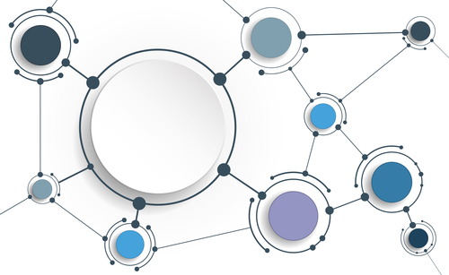
Before State
System complexity was inhibiting speed to market
Dozens of legacy systems performing similar functions
Thousands of product rules
Inconsistent business processes across regions
Manual development, testing and deployment processes
Integration: square pegs, round holes
Releases cycles measured in months
Simplification and modernization required to enable business agility
Notes:
Large families of systems
Customer support
Door to door and alternate(partner) channels
Dispatch
Repair and technical support
Flow of a call
Customer calls in based on a flyer at their door
Touches the rep, who needs to look up details
Purchase process touches bundles, order management, product details, and billing
Some kind of dispatching logic needs to figure out what the capacity is of the field technicians, and match to customer need
Provide material and instructions to a Verizon technician doing the work
Get billed, live happily ever after.
This is only if everything works great. Potential for many permutations, changes, fallouts due to events that may or may not be controllable
Add geographical complexity (different regions have different markets pressures, different regulations)
Mergers and acquisitions meant each of the functions and capabilities done in slightly different systems and different ways
What does a change process look in this environment?
We have some amazing dev teams
Technical talent and technical leadership that wants to do the right thing
Code is inventory, until it (and the function it represents) gets into production, it is a form of waste
Dev writes the best code there is, it is beautiful square peg, and it is not until integration that we realize they are all going into round holes

Slide 5
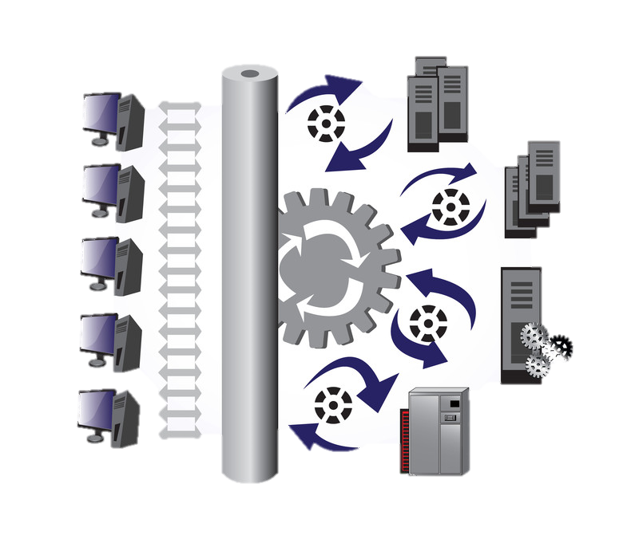
What We Did
Re-architect the back-ends and mid-tiers
Conscious decision to get away from monolithic thick clients
Redesign the infrastructure
Break down the silos
DRIVE AUTOMATION
Notes:
Simplification and decommissioning
Each decommissioning effort drives additional work into the pipeline
The goal was to get to one system from 44 over 3 years
Modernization of technologies
Sometimes, you do have to do things differently to get away from years of accumulated technical debt
Simplified the stack, built up a team that worked on .Net
Modernization of architectures
Building the right service oriented architecture, with backwards and forwards compatibility contracts
Ability to treat internal components like back boxes
Decouple changes/linkages
Redesign the infrastructure
Infrastructure is cheap (IF… you can manage it in a modern, automated fashion)
Automate all the things!
There are no special snowflakes : DB story

Slide 6
DevOps – Working together
Development
Build simple, reliable, personal experiences that delight the customer
Operations
Build simple, reliable, personal experiences that delight the customer
HowTo: DevOps, the Romance
(Working title: The Phoenix Project)
Notes:
Personal story:
New Operations role
Disconnect between development goals and ops team goals
Changes cause defects!
Answer: No more changes!
Stagnation is not a great business strategy, especially in a fast moving marketplace
The real answer: Learn to do changes better (Jez Humble puts it much better: if it hurts, do it more often, and bring the pain forward)
Start with an explicit declaration – Ops goals are the same as dev goals
Together, we are better
Story: Learning to do changes better
Identifying things when they break was the key issue keeping up from moving faster
Finding issues faster across the system
CoA monitoring – realtime data that shows errors – dev built that
Stop fighting your users – get as close to their experience as possible, build trust
Confidence is your users trusting you even when you fall
Every team contributes via their unique skills/insights – ops deploying test machines into the field that provides 24x7 awareness
If these three steps sound familiar, yes, they are almost identical to the recipe in my favorite Howto book

Slide 7
Impact
Flexibility
Changes
6/year → 2/week
Agility
Automated Releases Hours → Minutes
User Opinion
IT as a Necessity → IT as a Competitive Advantage
Quality
30% reduction every year in issues/incidents
Notes:
Additional benefits
Secondary decommissions removed hundreds of apps from the portfolio, reduced cost of IT spent on legacy by tens of millions of dollars each year
Enterprise releases across the portfolio moved to once a month
individual systems moved into 1-2 week release trains
Considerable pull through effect

Slide 8
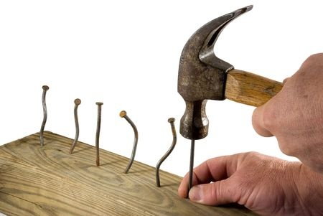
Lessons Learned
Focus on the business result
Leadership is key – support and air cover
Build safety nets with scalable and redundant infrastructure – the infrastructure is cheap, but managing it is expensive
Automate everything

Slide 9
What’s Next @ Verizon- Scaling Culture Change
Rinse and repeat early DevOps success at a larger scale
Establish corporate-wide DevOps program
Develop platform and program model
Lean Six Sigma business and measurement model
Measure progress and forecast
Notes:
Unshackle the talent
This whole exercise has been to step back and enable dev/app/ops teams to show off
Builds enthusiasm
Establish some guardrails using metrics
But let the teams show you where to go
Build great partnerships
Network
Security
Legal
Audit
Once they see the benefits, they usually supporters/promoters

Slide 10

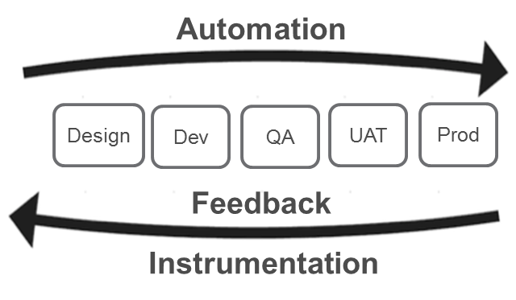











Creating a Corporate-Wide SDLC Toolchain
→
Selenium
CLOUD FOUNDRY
Dedicated team to build a standard + help direct technology teams
Build it and they will come (sort of) – still need to train and provide procedures
Notes:
Don’t be prescriptive
Stifling innovation and improvement is not the goal
You cannot possibly know everything
Be opinionated – based on experience/expertise/real work examples
Drive through principles:
code in one place, visible to all
sharing of best practices
transparency of the state of the system
end to end automation via CI/CD
Some tooling is inherently better for these principles(think capability, not product or brand)
Champion the better SDLC
Great place to practice what you preach – build an agile, demo driven, platform team that partners well

Slide 11





Measuring Success
As we onboard hundreds of apps onto the DevOps process and toolchain, every team is asked to measure and set goals across standard parameters
Cycle Time
Deploy Frequency
Months → Days/Hours
1 / Month → Daily/Weekly
Defects per Feature
Financial Impact
20%-50% Reduction
↑ % Benefit
Notes:
Friendly competition is good
But don’t make teams compete against each other where possible
Make them compete with their current selves
Metrics help this tremendously

Slide 12
Where We Need Help
Standardization in measurements
How do you measure business benefits?
How do you define success criteria?
DevOps enhances customer experience and the business, while improving the lives of IT professionals
Help us show the world that it is okay to be selfish and build a better way of working

Slide 13


chivas.nambiar@verizon.com
Chivas Nambiar

